Slide 1
ATM SIMULATOR PROJECT
PRESENTATION

Slide 2
Project Profile
Project Title : ATM Simulation System
Front End Tool : Tkinter
Back End Tool : SQLite Server
Project Platform : Python 3.9
Project Guide : Mr. Yusuf
Developed By : Okedokun Olajide
Ola Oluwatoyosi
Ubah Samuel

Slide 3
WHAT IS ATM
An ATM is an electronic device which allows a bank’s customer to make financial transactions in a public space & check their account balance at any time without the need for a human teller.
The customer is identified by a plastic ATM card with a magnetic stripe or a plastic smartcard with a chip.
Services available through an ATM v Withdraw cash.
Transfer money between accounts.
Obtain account balance.
Make deposits of cash and checks

Slide 4
1.0 Introduction
1.1 Purpose
Using an ATM, customers can access their bank accounts in order to make cash withdrawals (or credit card cash advances) and check their account balances as well as purchase cellphone prepaid credit. If the currency being withdrawn from the ATM is different from that which the bank account is denominated in (eg: Withdrawing Japanese Yen from a bank account containing US Dollars), the money will be converted at a wholesale exchange rate. Thus, ATMs often provide the best possible exchange rate for foreign travelers and are heavily used for this purpose as well.
ATMs are known by various other names including Automated Transaction Machine, automated banking machine, cashpoint (in Britain),money machine, bank machine, cash machine, hole-in-the-wall, Banc mat (in various countries in Europe and Russia), Multi banc (after a registered trade mark, in Portugal), and
1.2 Scope
The main purpose of the ATM division and information service is to provide the customers financial flexibility, worldwide acceptance and round-the clock convenience. Bank issues only VISA Credit Cards, the renowned Credit Card brand. Cardholders can purchase goods/services up to the credit limit and can reuse the credit facility upon repayment. Credit Card is a safer substitute to cash and is the major mode of payment worldwide. Standard Chartered Bank is the first to introduce the TAKA CREDIT CARD. The card is issued basically to a person’s name and the specific person can use the card in anywhere in Bangladesh. The business activity of Premier Bank Credit Card section is to keep the records of all sales and customers’ requests, the information of cardholders and reports them to necessary documents

Slide 5
2.0 Testing
Here APPLICATION works as main class. All other classes are related with this class.
APPLICATION does following operations:
Reference: Entering customer code represents inserting ATM card into ATM machine.
Home window contains bank title with entry request where user have to enter customer code.
If he/she is a registered user and customer code is correct, a new page with pin request to login and to do further operations. like:
Check Balance
Withdraw
Deposit
Transfer
The app is tested against test data in the database.

Slide 6
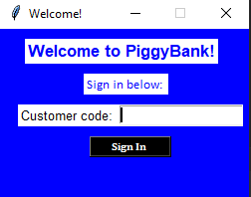
2.1 The Welcome Page
If user is registered in the banking system from homepage they have to enter their customer code on the first page.

Slide 7
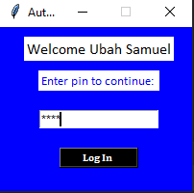
2.2 The Authentication Page
If the customer code exists in banking system database, a new login page displaying the customer name and a field to enter pin comes up.

Slide 8
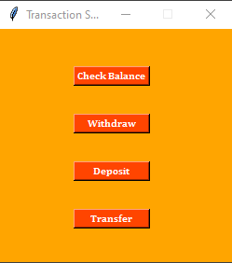
2.3 Transaction Page
The transaction page contains four options for the user they can choose what transaction they need to do.
Check Balance
Withdraw
Deposit
Transfer

Slide 9
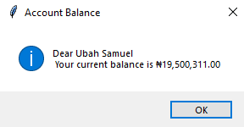
2.4 Check Balance Window
The check balance window displays the customer name and account balance

Slide 10
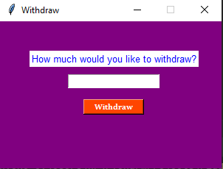
2.5 Withdraw Page

Slide 11
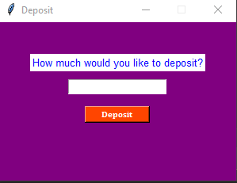
2.6 Deposit Page

Slide 12
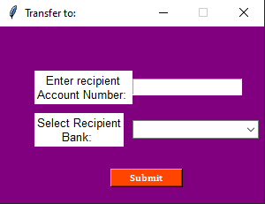
2.7 Recipient Page
Once the transfer button is clicked, the recipient page comes up with entry request for 10 digit recipient account number and recipient bank

Slide 13
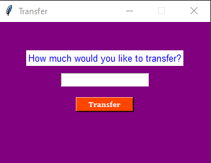
2.8 Transfer Page
After entering recipient details, a new page requesting the amount comes up.

Slide 14
3.0 Conclusion
Regardless of what we think of ATM machines, there is no doubt that they have changed the world and the way in which we do things. For example, think how many times we have been out somewhere only to discover we have no cash and we are out of checks, ah, but in the corner, there is an ATM machine. In the blink of an eye, we swipe the card and now have cash on hand. In addition to pulling money out, the ATM machine also makes it convenient to deposit money, transfer money, and check balances. Best of all, to use an ATM machine, we do not have to go to the bank. We will find ATM machines at other banks, grocery stores, shopping malls, along the roadside, Buckingham Palace, airports, in casinos, and even on the South Rim of the Grand Canyon. For this reason, ATM machines are extremely helpful!

